Slide 1



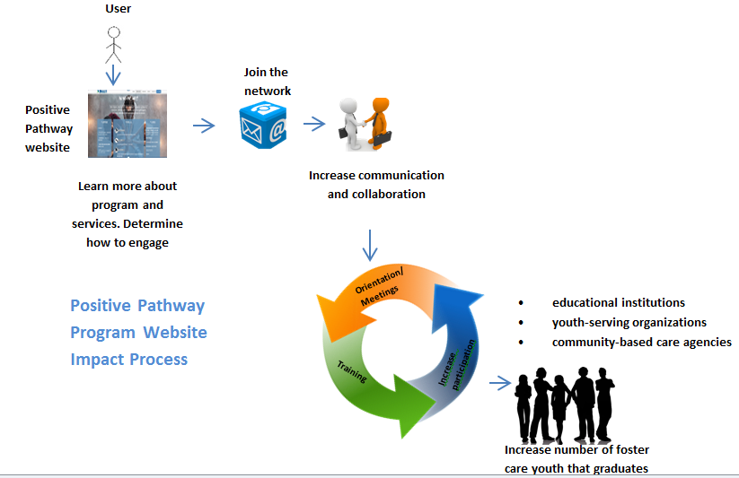

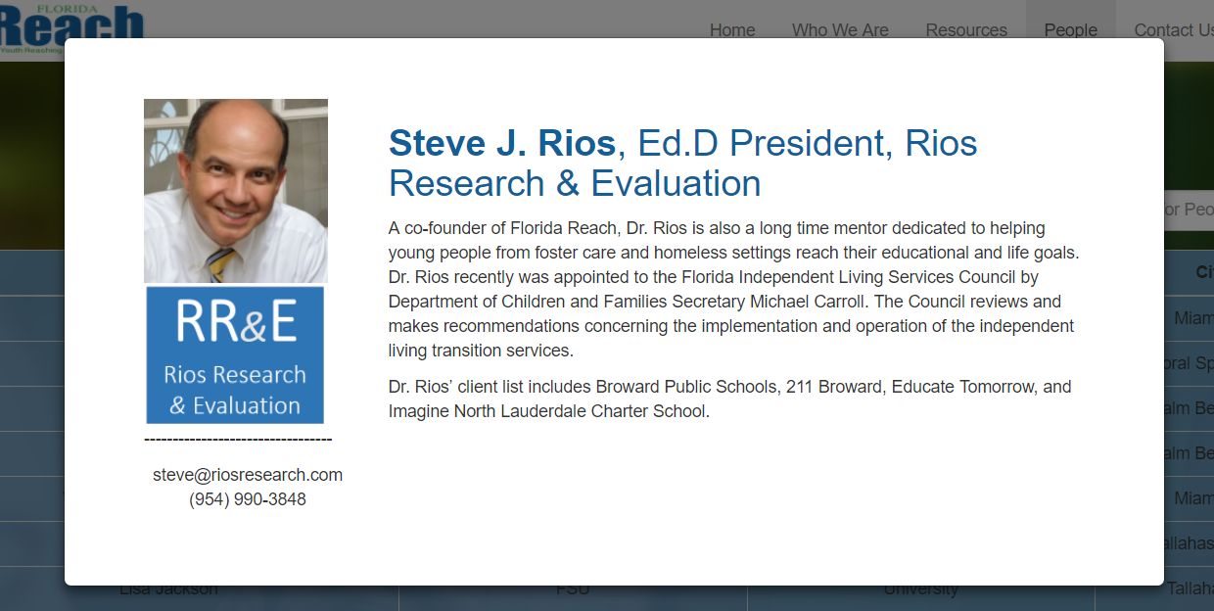
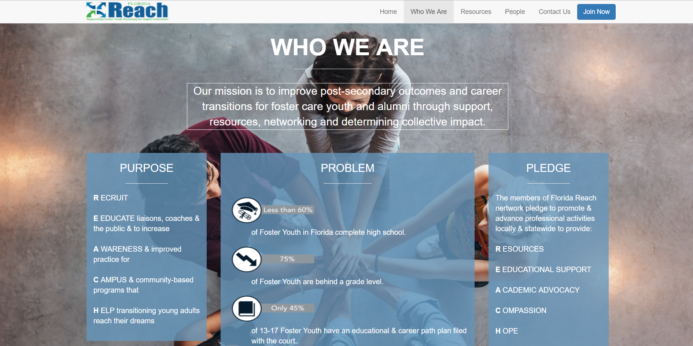

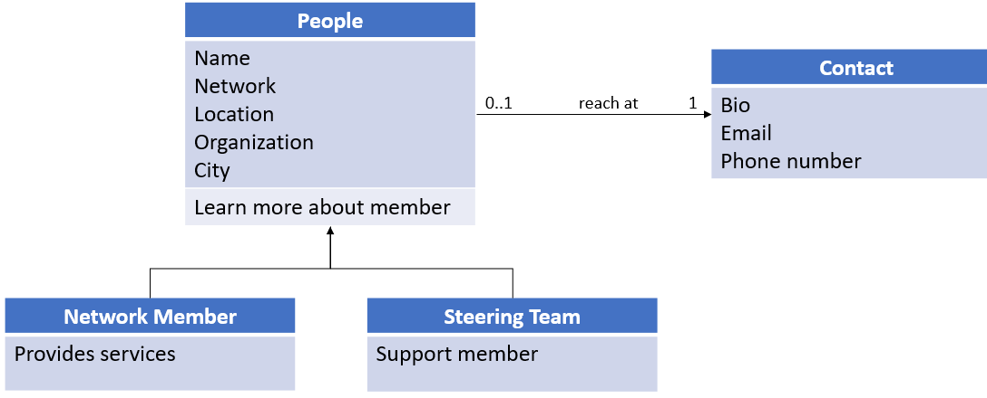
School of Computing & Information Sciences
IDS 4894, 2017, Summer
Apps, Arts and Issues:
APPlying the Arts to Digital Communication
Student: Claudia Gourdet, Florida International University
Mentor: Francisco Ortega, Margo Berman, Florida International University
Instructor: Masoud Sadjadi, Florida International University
Problem
Lack of a platform to communicate amongst members of a network that support foster youth
Lack of user friendly website for members to access vital information and resources
Solution
Develop a website to encourage collaboration and increase number of members of the network
Incorporate pages such as meeting agenda, membership directory and professional development opportunities
Current System
Network members access Information through 3rd party website –Department of Children and Families (DCF)
User must search for section in list form, information is not direct or easily accessible
Screenshots
Requirements
Website accessible with any
devices and browsers
Contains components and features for communication, training and information learning
Allow Network members and individuals interested in supporting the ability to serve and support in various ways.
System Design
Implementation
Frameworks and Technologies:
Angular, NodeJS, Bootstrap, Jquery
Programming Languages:
HTML, CSS, JavaScript, Typescript
Verification
Tested all user stories to ensure they worked properly.
Tested various components to ensure they are functional.
Object Design
Summary
First platform designed to support a network of professionals that works with foster youth in college
Future development will focus on providing information directly to student
(Website + mobile App)
Acknowledgement
The material presented in this poster is based upon the work supported by Dr. Steve Rios and Prof. Margo Berman. I am thankful to the help that I received from my group members: Ramses Melo, Jose Ayala, Derek Hernandez, Enrique Hidalgo, Mariel Juarez, Nathalie Llaneza
Notes:
1

